Slide 1
Year 2 Parent Meeting
AUTUMN term 2022

Slide 2
Welcome to the new school year. We hope you enjoyed a well deserved summer holiday!
Well done to all children and parents for a positive start to the new academic year.

Slide 3
Staff in
Ms Sassoli and Ms Barnes-Weston
Mrs Wright
Mrs Rayner – Wednesday afternoon PPA cover teaching RE.

Slide 4
Aims of the meeting:
Inform you about the term ahead.
Discuss the Autumn Term Curriculum.
Share examples of End of Year Expectations.

Slide 5
Curriculum
Maths will be taught daily to develop our fluency, reasoning and problem solving skills. We will be learning a variety of skills including place value, addition and subtraction, money and multiplication and division.
We will be completing daily English and Phonics lessons. We will be enjoying a range of texts including a range of writing tasks around traditional tales. We will then move in to making Victorian toys and writing instructions for others to follow to make them.
In art this term we are learning to paint! We will be taking inspiration from the artist Piet Mondrian.
In DT we will be working with fabric and making our own bunting using a running stitch
In ICT we will explore coding and be looking into how algorithms work. We will also discover more about online safety.

Slide 6
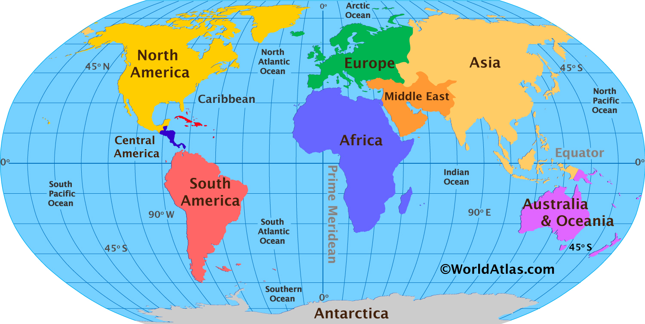
We will be exploring local, national and global maps, developing our understanding of navigating using an atlas to find countries, continents and oceans.
We will also be making our own maps to navigate! This will help us investigate changes in our local area observing changes in human and physical features of Isleham.
We will learn how to draw and ‘read’ maps using their symbols and compass directions.

Slide 7
In Autumn 2 we will be exploring the history of toys and whether we would like to play with toys of the past. We will learn how toys have changed and put them into chronological order. In addition, we will be sorting toys according to a criteria and making some Victorian toys for ourselves! We will link this to our science topic for the Autumn term which is materials and investigate how materials have changed for toys over the years.

Slide 8
Curriculum
In RE this term we will be learning about Judaism and considering ‘why Jewish families talk about repentance at New Year. We will then explore Christianity and discuss ‘why Jesus was given the name Saviour?’. We will also be doing our annual Nativity production and will recap the Christmas Story.
In PE we will be continuing with swimming until Autumn half term on Thursdays. ON Mondays we will be teaching co -ordination skills and balancing skills.
In Music, our weekly lessons we will develop using our voices expressively and creatively, learn how to play tuned and untuned instruments and listen with concentration to a range of music focusing on different aspects.
In PSHE this term we look into responsibilities, rules and rights. We then find out about how we can be good friends to others. In addition, recognising the diversity in friendship is critical and how patterns within friendships can change over time. We will focus on how we can find strategies to resolve challenging situations in friendships.

Slide 9
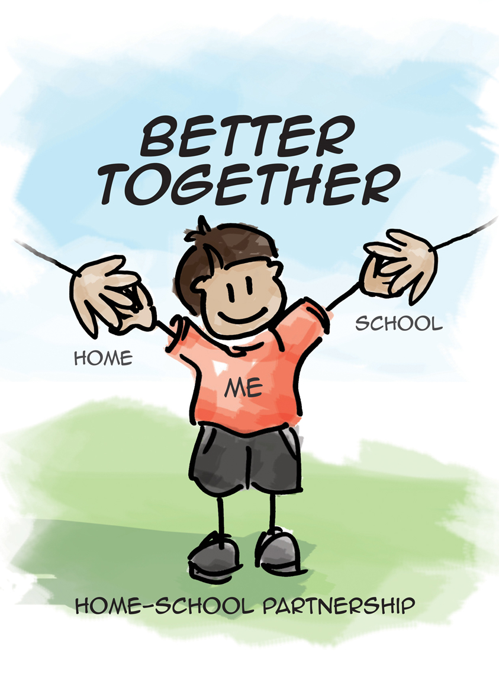
Phonics / Reading
We follow the Song of Sounds phonics programme focusing on stage 3.
The link below will take you to the song we sing at the start of the lesson and has all of the stage 3 sounds we will be learning in year 2.
https://www.youtube.com/watch?v=sZvvix2bx98

Slide 10
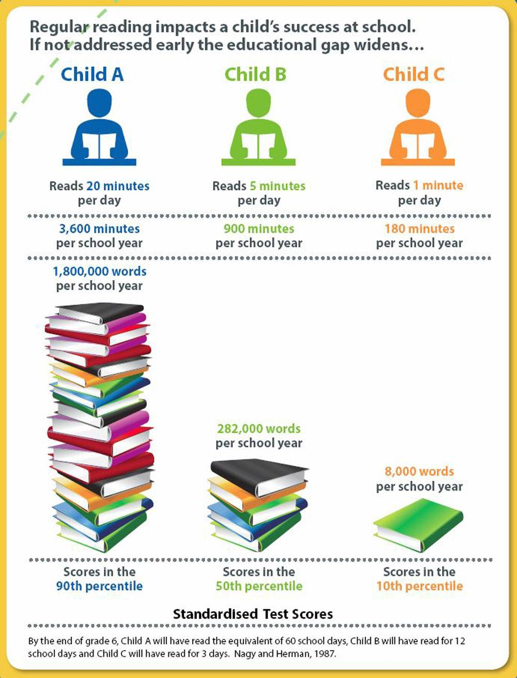
Across the week the teacher reads with all guided reading groups. We read a group text, discuss it and share ideas, answer comprehension questions and inference questions. They will take a weekly ‘show off’ book home after these sessions.
Each morning, children are asked to change their home reading book if needed. Please remind your child if they need to change their book each morning.

Slide 11
Ways you can support your child at home
Practise the weekly spelling words- lists available on Spelling Shed. New lists set on a Thursday tests on a Thursday too.
Expose children to their daily reading book from school which is matched to their current phonics level and reading band. You could also begin to introduce a wider range of stories which include longer texts. It is important they are exposed to vocabulary beyond their reading ability.
Allow your child to see you reading for pleasure. It may be fiction, non-fiction or poetry.
Allow your child to practise their reading skills. Encourage blending aloud, as well as in their heads.
Talk about books. Ask the children what is happening, how the characters are feeling and what they have enjoyed.
Use ambitious vocabulary, explaining its meaning.
Read rhyming books together. Ask the children to fill in missing parts and join in with repeated refrains.
MAKE READING A PLEASURE NOT A CHORE!

Slide 12
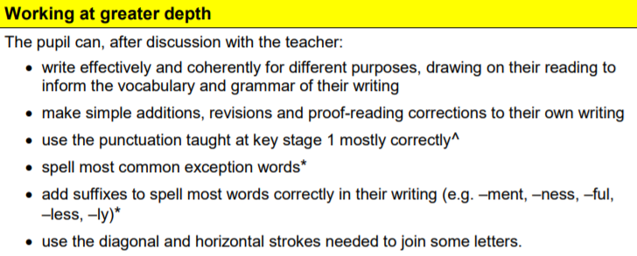
Writing

Slide 13
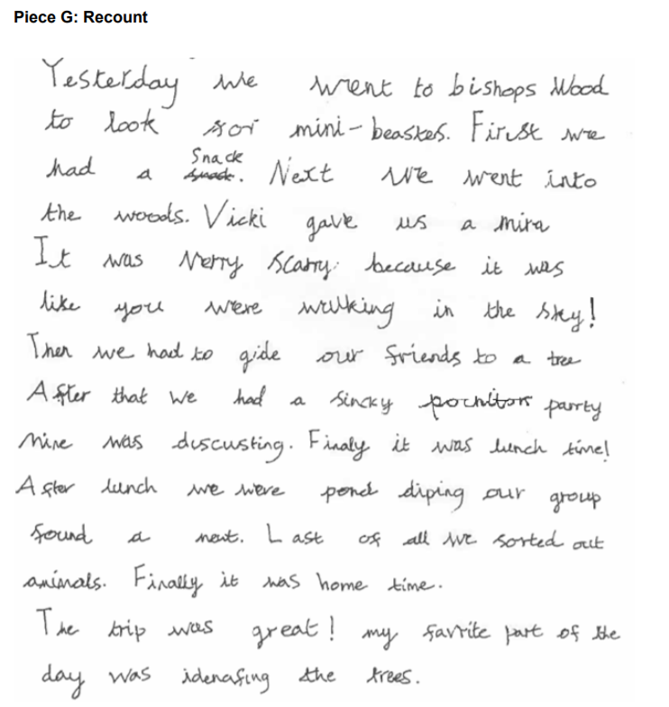
Working at the age related expectation

Slide 14
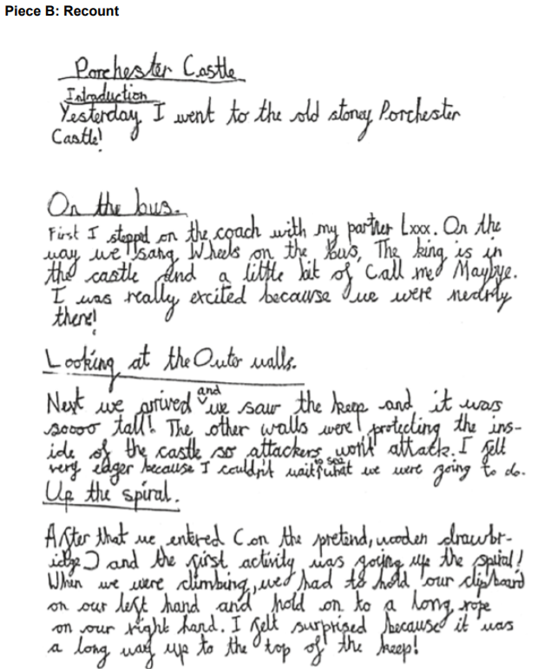
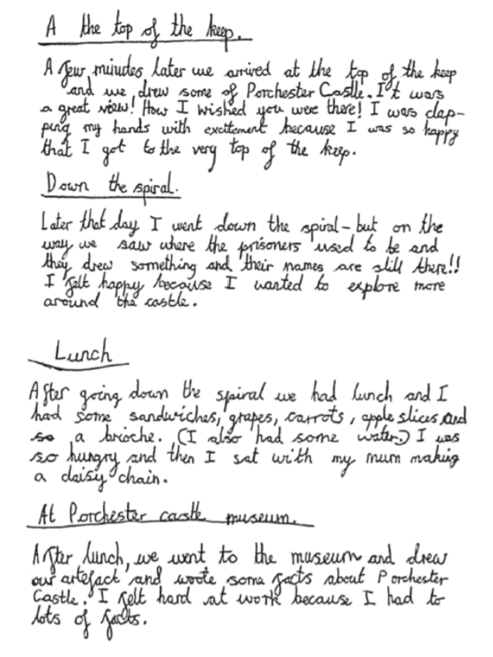
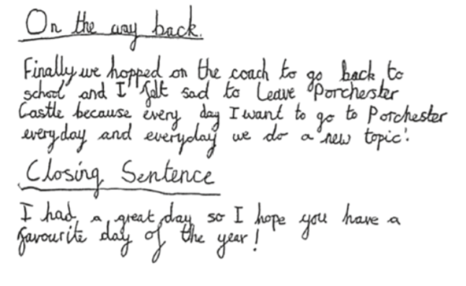
Greater Depth

Slide 15
Ways to help at writing at home
1. Read to your child-While children do learn new language and ideas from speaking and listening, the type of language we use in writing is often very different from that in speech. Reading regularly to your child, especially longer chapter books that they might not be able to yet read independently, is a great way to support their writing. While your child will have some favourite books and types of book that they’ll want to listen to again and again, try to make sure they get to hear a range of different types of books, including fiction and non-fiction. This is useful for their writing because it provides models for a wide of language styles.
2. Have your child to read to you- Making time to hear your child read isn’t just good for their reading. Seeing words in print helps them to understand the words, to spell them, and to see how grammar and punctuation are used to make meaning. When you read, occasionally talk about why the author has decided to include something and how they written it. For example: ‘I wonder why the author has chosen to describe the castle as “gloomy”? I wonder what that tells us about what might happen there?’
3. Try some real-world writing- Writing for a real purpose can be a great way to fit in some practice. Writing cards, shopping lists, or letters/emails to relatives can be motivating real life reasons for writing, and can show children how useful it is to be able to write well. Your child might enjoy keeping a diary or writing short stories based on books they have read or toys they enjoy playing with. Be sure to encourage your child to write about what most interests them, as this is the best way to keep them enthusiastic.
4. Tell stories aloud- Giving your child the opportunity to tell stories orally is a great way to get them used to structuring their ideas and using adventurous language. If they’re not sure where to start, see if they can retell a story that they already know well, like Little Red Riding Hood or Three Little Pigs.

Slide 16
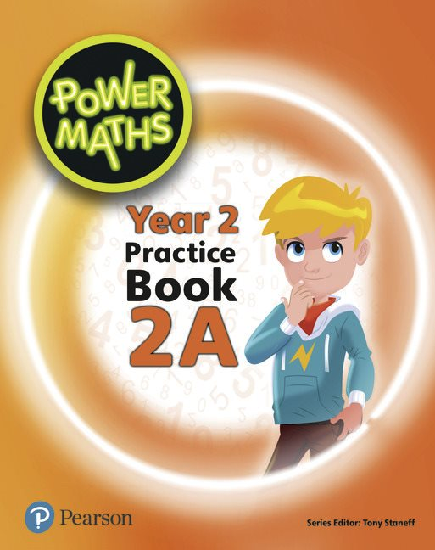
Maths
At the heart of Power Maths is the belief that all children can achieve. It’s built on an exciting growth mindset and problem-solving approach.
Power Maths aims to spark curiosity and encourages rich mathematical talk.
Units coming up:
Numbers to 100 (place value)
Addition and subtraction
Money
Multiplication and division

Slide 17
Ways you can help at home
Practise counting in 2s, 3s, 5s and 10s forwards and backwards- could do this in an active way going up/down the stairs, bouncing on the trampoline etc.
Practise 2, 5 and 10 times table fluently.
Work on methods at home- guides to be posted to Class Dojo.
Practise sharing items into equal groups and understanding the groups are parts of a whole.
Any practise of telling the time or use of money in daily situations.

Slide 18
Homework
1. Reading – This needs to completed on a daily basis with your child for at least 10 minutes. Please record your observations in your reading record which will be checked at school. It is important that the children are able to talk about what they have read so please ask them lots of questions to ensure that they have understood the text.
2. Spellings - We will put spellings on Class Dojo each week for the children to learn and some strategies they can use to support their learning of the weekly words. There will be opportunities in school for the children to practise before our weekly progress check. You can log on to www.edshed.com to access Spelling Shed games
3. Multiplication tables – Children will be provided multiplication tables to complete each week on Class Dojo. In Year 2, children need to know their 2x, 5x, and 10x tables and will have a weekly progress check. This will develop their fluency answering these questions as they look ahead to KS2.

