Slide 1





Reception Class Parent Meeting
AUTUMN term 2022

Slide 2

Welcome to Reception
We hope you all had a wonderful Summer.
Thank you all for such a positive start to the new academic year and the warm welcome we received on home visits.
The children are settling in really well.

Slide 3
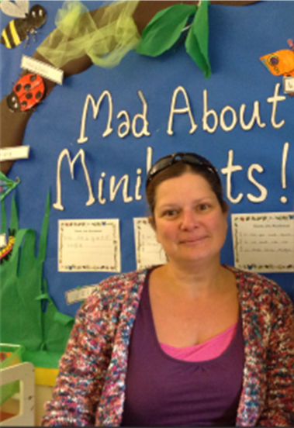
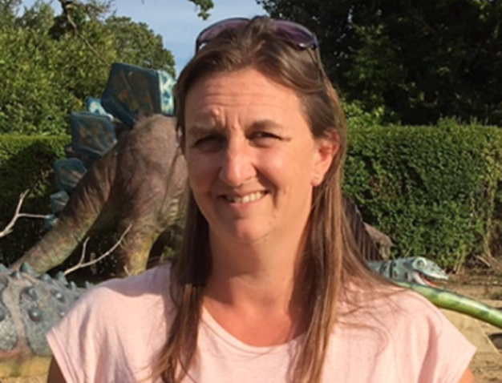
Staff in Reception
Miss Simmons (Class Teacher)
Mrs Dray (Teaching Assistant- Monday to Friday)
Mrs Minshull (Teaching Assistant Monday to Friday AM)
Mrs Rayner (PPA Cover)- Monday PM

Slide 4

Aims of the meeting:
Inform you about the term ahead.
Discuss the Autumn Term Curriculum.
Dates for your diary.
Reception Year Expectations.

Slide 5
Curriculum
From September 2021 we will be following the new statutory Early Years Foundation Stage (EYFS) Curriculum. This includes a new focus on early language and extending vocabulary to improve outcomes at age 5.
There are 7 areas of learning and development in the EYFS:
‘Early Learning Goals’ summarise the knowledge, skills and understanding that all young children should have gained by the end of the academic year in which they turn 5, otherwise known as the Reception year. Information about what we would expect from an average child by the end of Reception year is displayed in our cloakroom area at school and can be found here: https://assets.publishing.service.gov.uk/government/uploads/system/uploads/attachment_data/file/974907/EYFS_framework_-_March_2021.pdf
The 3 prime areas:
Communication and Language
Physical Development
Personal, Social and Emotional Development
The 4 specific areas:
Literacy
Maths
Understanding the World
Expressive Arts and Design

Slide 6


Autumn Term Headlines
In the EYFS we theme our learning around a different topic each half term.
Learning in the first half of the Autumn Term will be themed around the topic ‘All About Me’.
Children will talk about themselves and learn about each other. We talk a lot about class and school rules. Learn how to be a good friend. They will explore their new surroundings at school and the local environment.
We hope to invite some visitors into school to help bring the topic to life.
We try to use a different book to help focus our learning each week.
Gradually over the term, we will be supporting children to initiate
their own learning too.

Slide 7


Phonics / Reading
Phonics is a way of teaching children how to read and write.
At Isleham we have recently adopted a new phonics scheme called ‘Song of Sounds’.
Children will take part in daily phonics activities to help them learn letter sounds.
Each child will read in a small guided group together. These books will be changed weekly and chosen carefully based on each child's ability to read.
We encourage lots of reading for pleasure. Children will be given an opportunity to choose another book from the library each week. This is usually a book which will need to be shared together at home.
Home reading routines- before bed is a great time to read. We don’t expect you to read the whole book each day but we do ask that you read part of a book daily and make a comment in your child’s reading record to demonstrate your commitment.

Slide 8
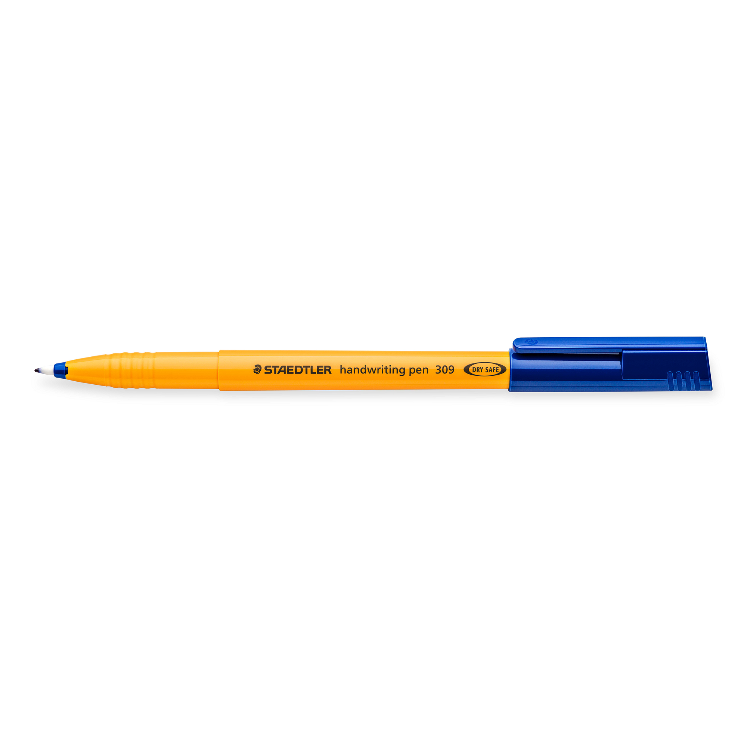

Writing
Every child is unique and they tend to start their learning journey in Reception at different starting points.
We use ‘Finger Gym’ activities to develop their fine motor skills and strength in hands & fingers.
Demonstrate and support each child in learning how to hold and use a pencil effectively.
At Isleham School we teach children to form cursive handwriting using ‘Flying with Phonics’ to support this. Supporting videos can be found here: https://youtu.be/CMfnwSZ2vpo
They will learn how to use their phonic knowledge to identify the initial sound e.g. c for cat.
Before moving on to using phonics to segment the word c-a-t ‘cat’ before writing.

Slide 9
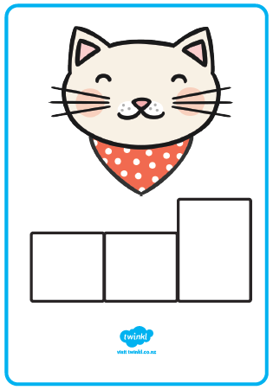
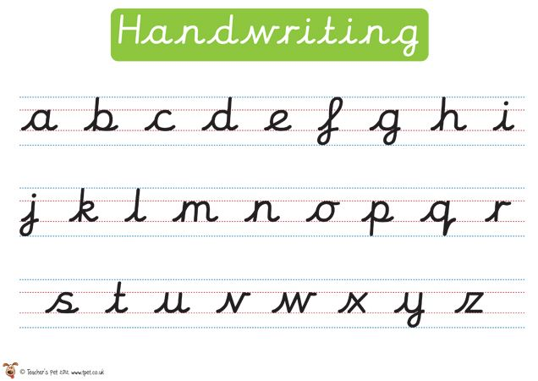

Writing Examples

Slide 10


Maths
Numberblocks are loved by children in Reception.
We use the Numberblocks characters to introduce children to early number and concepts of number.
The storylines highlight and develop key mathematical ideas and support early mathematical understanding.
Follow on activities are used to bring numbers and ideas to life in the world around them.
Remember to involve your child in maths at home wherever you can when measuring, weighing and baking.
In the Summer Term we move on to undertake some maths activities using the ‘Power Maths’ scheme.

Slide 11

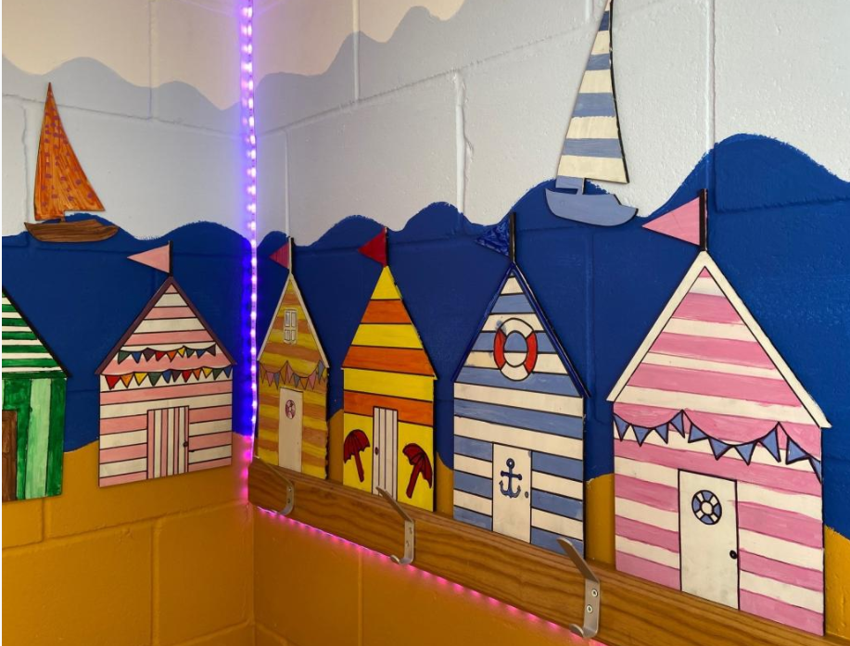
PE Days
This term our PE session will be held in the hall on a Monday morning.
The children will visit the hall this week for a familiarisation session before their first PE session on Monday 19th September.
Children will wear their PE kit to school on that day. Please wear black joggers or trousers and a school jumper over the top if the weather turns cooler.
Whilst swimming for other year groups has already resumed, swimming for children in Reception does not start until the Summer Term.

Slide 12
Home Learning
Reading –10 minutes daily minimum. This must be recorded in the reading record for daily checking.
At the end of each week we will share a Reception weekly update with you via Dojo to inform you of the learning that has taken place that week.
This provides a great talking point for the dinner table at home.
We will also suggest ideas for follow on activities at home and important dates so please remember to read and check it each week.
We are very much looking forward to working in partnership with you all and an exciting year ahead.

Slide 13
Questions
If anything from this presentation has led you to think of a subsequent question, please pass these on to us via the office e-mail address which is: office@isleham.cambs.sch.uk

Slide 14
Thank you

