Slide 1





Year 2 Parent Meeting
2024

Slide 2


Welcome to the new school year. We hope you enjoyed a well deserved summer holiday!
Well done to all children and parents for a positive start to the new academic year.

Slide 3

Staff in
Ms Barnes-Weston and Mrs Grove
(Tuesday –Friday) (Monday)
Mrs Minshall is one of tthe teaching assistants every day- 9am- 1.50 pm.
Mrs Blazely-White is a teaching assistant every day 10.30am-3.20pm.
Mr Tull- Cover teacher for PPA on Tuesday afternoon.

Slide 4
Classroom organisation
Year 2 moves to whole class teaching rather than continuous provision that the children have experienced in Year 1.
Children will still have carpet sessions as a whole class for each lesson.
They will then be working at the tables for their independent learning.
Teaching staff will be moving around the class, supporting where needed and allowing children to grow their independence.

Slide 5
Classroom organisation
We encourage the children to start looking for ways around the classroom to support their learning and asking for help when they need it.
During the start of the Autumn term the children will have opportunities to have brain breaks and extra play in some of the afternoons to build up their stamina as they begin Year 2.
The children will be eating their lunches in the hall as they did in Year 1.
PE will be on Tuesday and Thursday afternoons.

Slide 6
Curriculum
Maths will be taught daily to develop our fluency, reasoning and problem solving skills. We will be learning a variety of skills including place value, addition and subtraction, money and multiplication and division.
English will be taught 4 sessions a week. Phonic sessions will be taught alongside theses lessons.
SPAG will be taught within English lessons as part of the 3 phases that we follow when exploring different genres.
Science will be taught by Mrs Grove on a Monday as a standalone lesson.
There will be an RE lesson each week taught on a Monday with Mrs Grove.
Topic lessons will be directly linked to the topic for each half term and will also feed into English and Art/DT lessons.

Slide 7
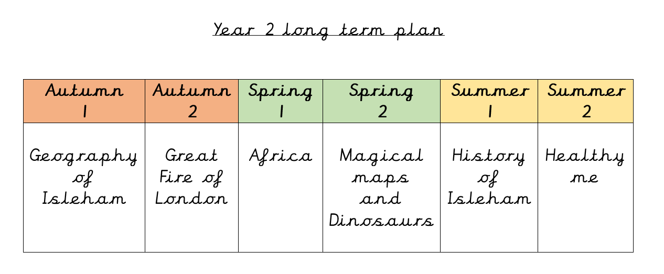

Slide 8

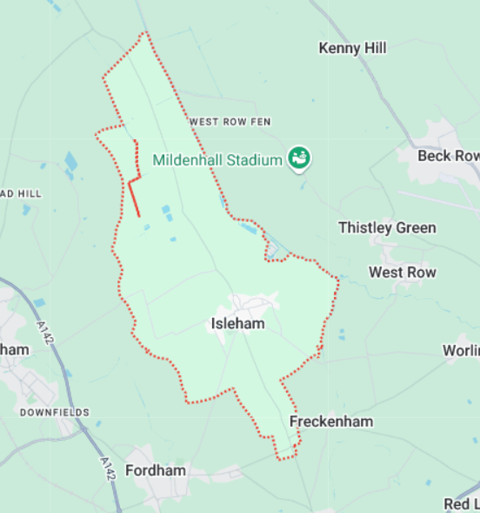

Geography of Isleham
We will be exploring our local area of Isleham. Looking at different maps that show where the children go to school.
We will be walking around the village to see different features and then plotting them on our own maps back in the classroom.
We will learn how to draw and ‘read’ maps using their symbols and compass directions.

Slide 9

In Autumn 2 we will be exploring the Great Fire of London. Looking into what happened during that time and the effects it had on the city.
We will be looking at the different types of houses and using these features to create our own.
The children will be learning about Samuel Peeps and exploring the Great Fire of London through different eyes.
A hands on experience day focusing on the events and what it would be like in 1666/

Slide 10
Assessment
Baseline- Children will be assessed against the Year 1 Power Maths end of year test to give an idea of where the children are in Maths. The children will be assessed on their phonic knowledge and against the reading levels.
Half termly the children will be assessed against what they have been taught to ensure they have the understanding of the topics they have just covered. This will enable us to ensure teaching meets their needs and any gaps are addressed.
At the end of every term the children will complete previous years SATs papers.
SATS have now become non-statutory for children at the end of Key Stage 1. We will still be using the SATs tests that will be published this year as they are a good indicator as to where the children are academically, however the children will know no different as they are in the same format as they experienced in Year 1.

Slide 11

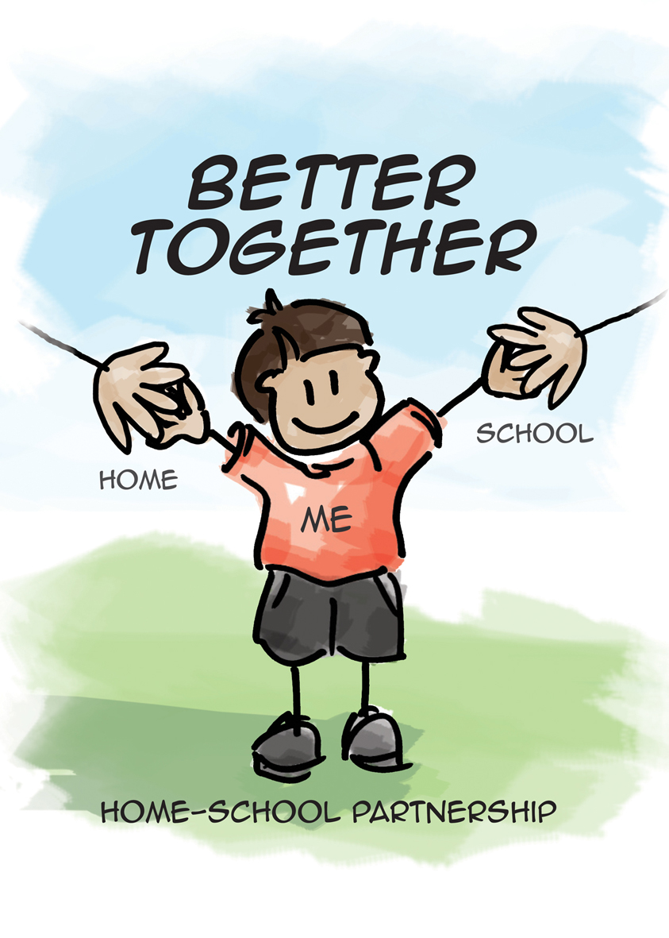
Phonics / Reading
This year we are going to start a new phonics scheme called Little Wandle.
It still follows the same sounds that need to be taught in Year 2.
The children begin learning the alternative sounds to ones they have focused on in Reception and Year 1. They will then move onto spelling patterns and rules later in the year.
Spellings will follow the sounds being taught in school.

Slide 12
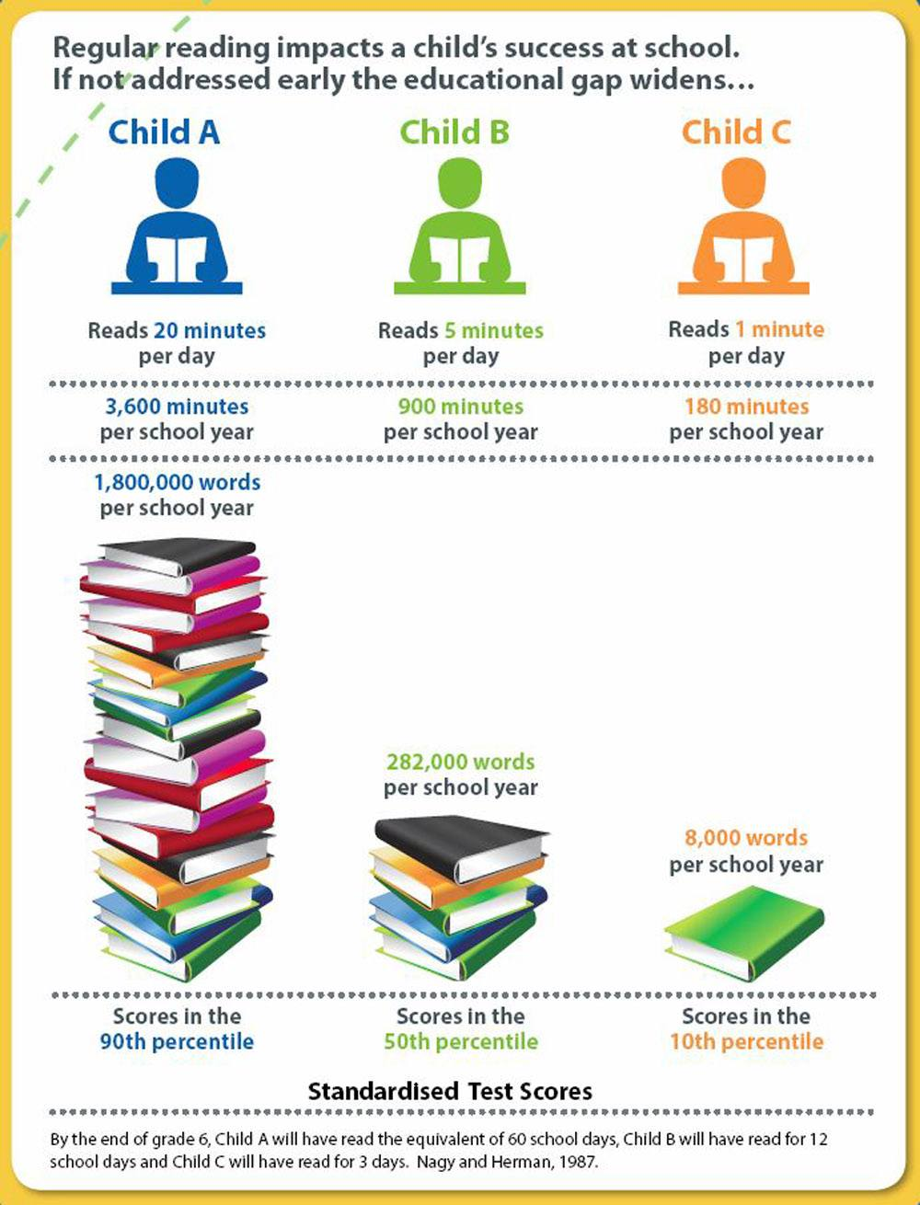


The children will read across the week with the teacher and teaching assistants. We read a group text, discuss it and share ideas, answer comprehension questions and inference questions. They will take a weekly ‘show off’ book home after these sessions.
They will swap reading days each week so please ensure books are in their book bags EVERY DAY!
Throughout the week the children will have the opportunity to change their tray book. Please remind your child if they need to change their book as this is part of their independence around the classroom.

Slide 13
Ways you can support your child at home with reading
Practise the weekly spelling words- new spellings will be given on a Monday from Mrs Grove and tested the following Monday. Any questions you have on spellings, please contact Mrs Grove directly.
Expose children to their daily reading book from school which is matched to their current phonics level and reading band. You could also begin to introduce a wider range of stories which include longer texts. It is important they are exposed to vocabulary beyond their reading ability.
Allow your child to see you reading for pleasure. It may be fiction, non-fiction or poetry.
Allow your child to practise their reading skills. Encourage blending aloud, as well as in their heads.
Talk about books. Ask the children what is happening, how the characters are feeling and what they have enjoyed.
Use ambitious vocabulary, explaining its meaning.
Read rhyming books together. Ask the children to fill in missing parts and join in with repeated refrains.
MAKE READING A PLEASURE NOT A CHORE!

Slide 14
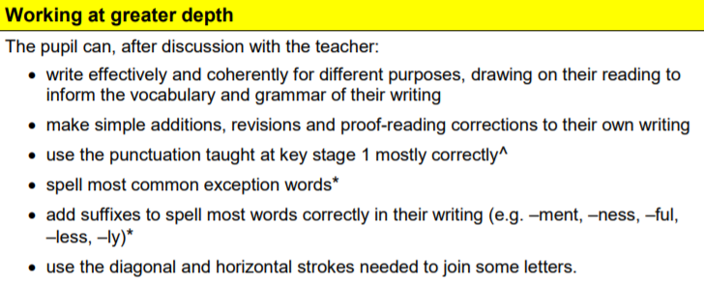
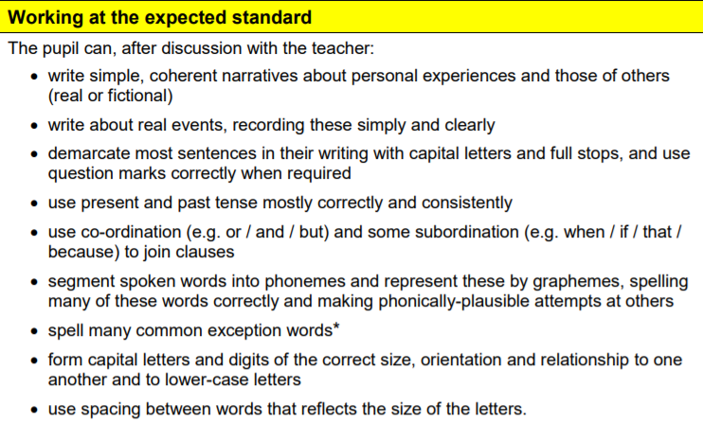
Writing

Slide 15
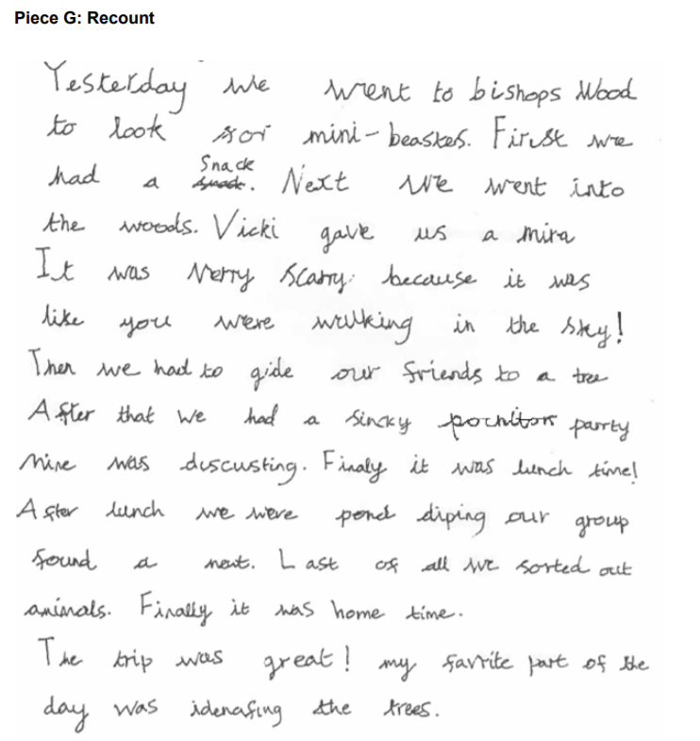
Working at the age related expectation

Slide 16
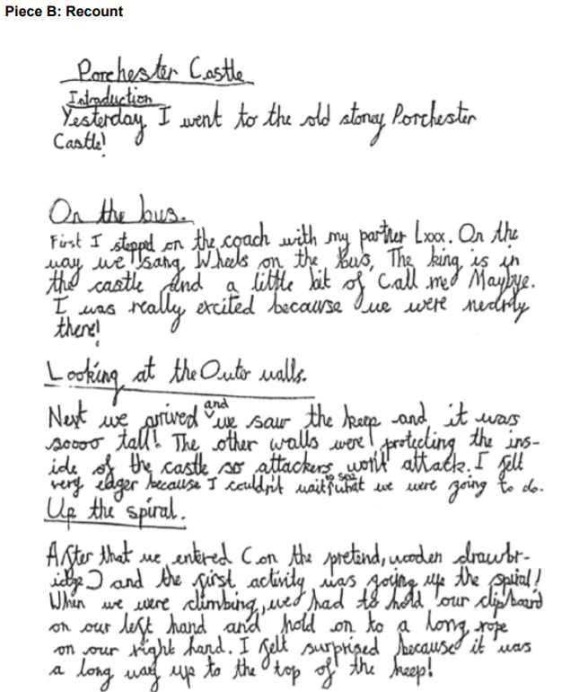
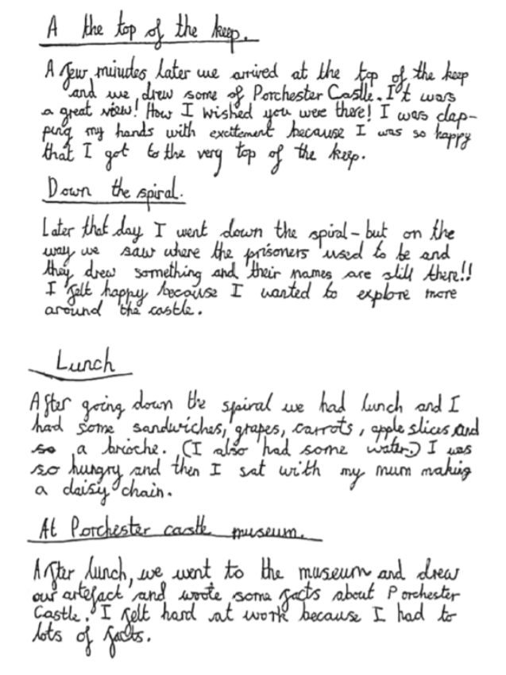
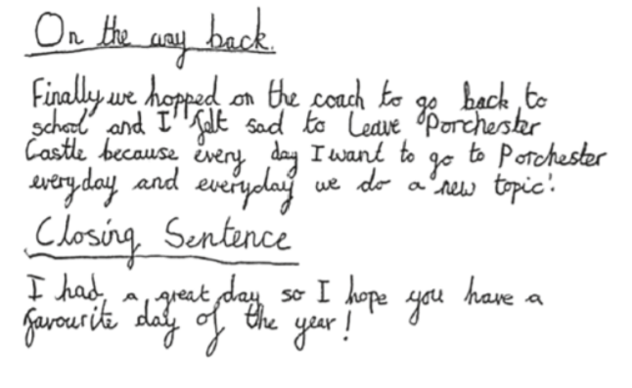
Greater Depth

Slide 17
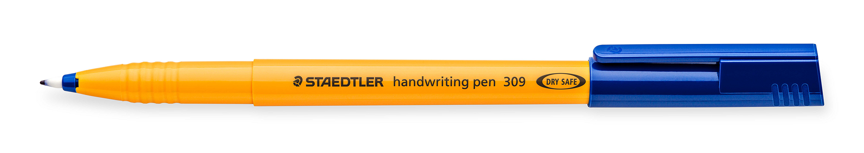

Ways to help at writing at home
1. Read to your child-While children do learn new language and ideas from speaking and listening, the type of language we use in writing is often very different from that in speech. Reading regularly to your child, especially longer chapter books that they might not be able to yet read independently, is a great way to support their writing. While your child will have some favourite books and types of book that they’ll want to listen to again and again, try to make sure they get to hear a range of different types of books, including fiction and non-fiction. This is useful for their writing because it provides models for a wide of language styles.
2. Have your child to read to you- Making time to hear your child read isn’t just good for their reading. Seeing words in print helps them to understand the words, to spell them, and to see how grammar and punctuation are used to make meaning. When you read, occasionally talk about why the author has decided to include something and how they written it. For example: ‘I wonder why the author has chosen to describe the castle as “gloomy”? I wonder what that tells us about what might happen there?’
3. Try some real-world writing- Writing for a real purpose can be a great way to fit in some practice. Writing cards, shopping lists, or letters/emails to relatives can be motivating real life reasons for writing, and can show children how useful it is to be able to write well. Your child might enjoy keeping a diary or writing short stories based on books they have read or toys they enjoy playing with. Be sure to encourage your child to write about what most interests them, as this is the best way to keep them enthusiastic.
4. Tell stories aloud- Giving your child the opportunity to tell stories orally is a great way to get them used to structuring their ideas and using adventurous language. If they’re not sure where to start, see if they can retell a story that they already know well, like Little Red Riding Hood or Three Little Pigs.

Slide 18
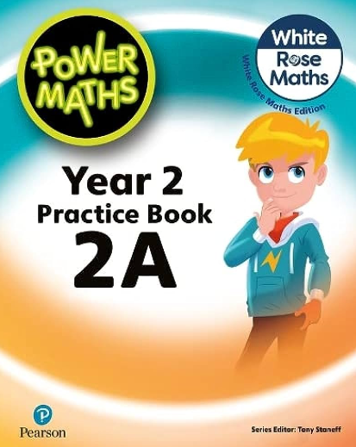
Maths
At the heart of Power Maths is the belief that all children can achieve. It’s built on an exciting growth mind set and problem-solving approach.
Power Maths aims to spark curiosity and encourages rich mathematical talk.
Units coming up:
Numbers to 100 (place value)
Addition and subtraction
Money
Multiplication and division

Slide 19

Ways you can help at home with Maths
Practise counting in 2s, 3s, 5s and 10s forwards and backwards- could do this in an active way going up/down the stairs, bouncing on the trampoline etc.
Practise 2, 5 and 10 times table fluently.
Work on methods at home- guides to be posted to Class Dojo.
Practise sharing items into equal groups and understanding the groups are parts of a whole.
Any practise of telling the time or use of money in daily situations.

Slide 20


Homework
1. Reading – This needs to completed on a daily basis with your child for at least 10 minutes. Please record your observations in your reading record which will be checked at school. It is important that the children are able to talk about what they have read so please ask them lots of questions to ensure that they have understood the text.
2. Spellings - We will put spellings on Spelling shed each week for the children to learn and some strategies they can use to support their learning of the weekly words. There will be opportunities in school for the children to practise before our weekly progress check. You can log on to www.edshed.com to access Spelling Shed games
3. Multiplication tables – Children will be provided multiplication tables to complete each week on Class Dojo. In Year 2, children need to know their 2x, 5x, and 10x tables and will have a weekly progress check. This will develop their fluency answering these questions as they look ahead to KS2.

Slide 21


